Slide 1
DSCI 619: Deep Learning Final Project
Lauren Schmiedeler

Slide 2
Part I
Indoor Scenes Image Classification

Slide 3

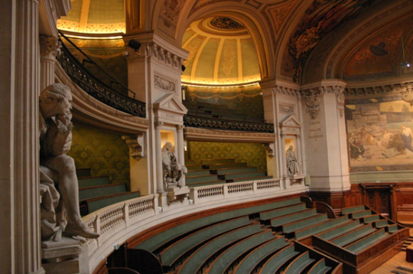
Data and Project Overview
The dataset used for this project is from Kaggle and contains 15,620 images, each of which depicts 1 of 67 different indoor spaces.
After removing 6 categories that have image quality issues, the dataset contains 14,056 images in 61 different categories.
The goal of this project is to predict the indoor space given the image.
art studio
auditorium

Slide 4
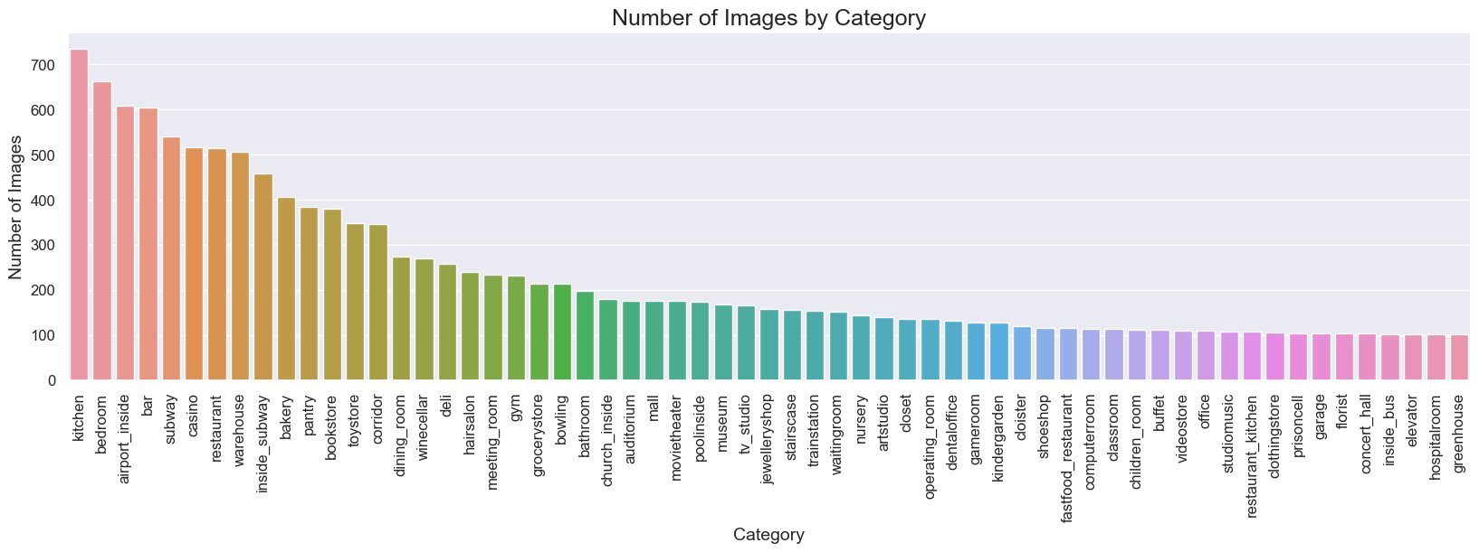
Preparation for Modeling
Find the number of images in each category.
The dataset is imbalanced, so overall accuracy is not a good metric by which to evaluate the models.

Slide 5
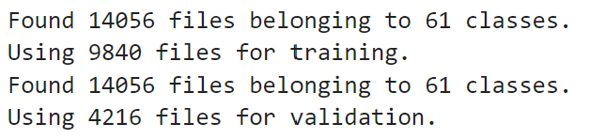
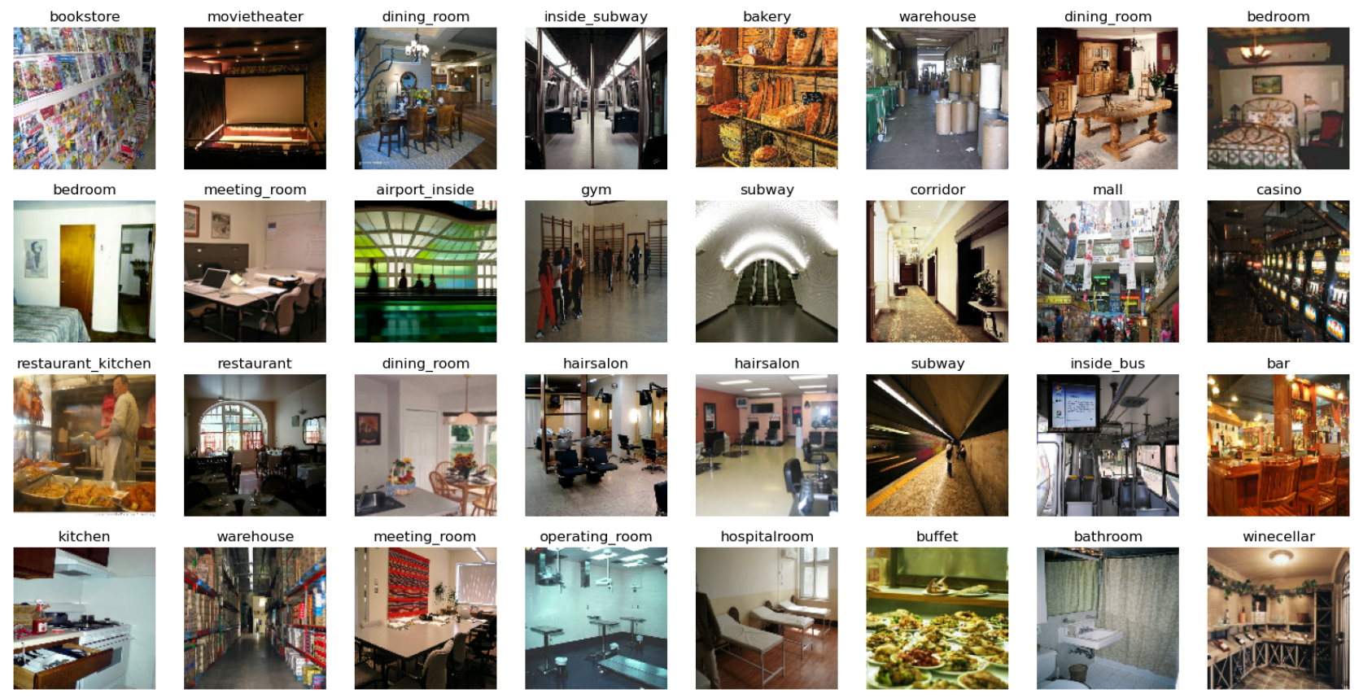
Preparation for Modeling
Split the data into a training set (70% of the data) and a test (or validation) set (30% of the data).
View one batch of the training data. Each batch contains 32 images and their respective labels (categories).

Slide 6
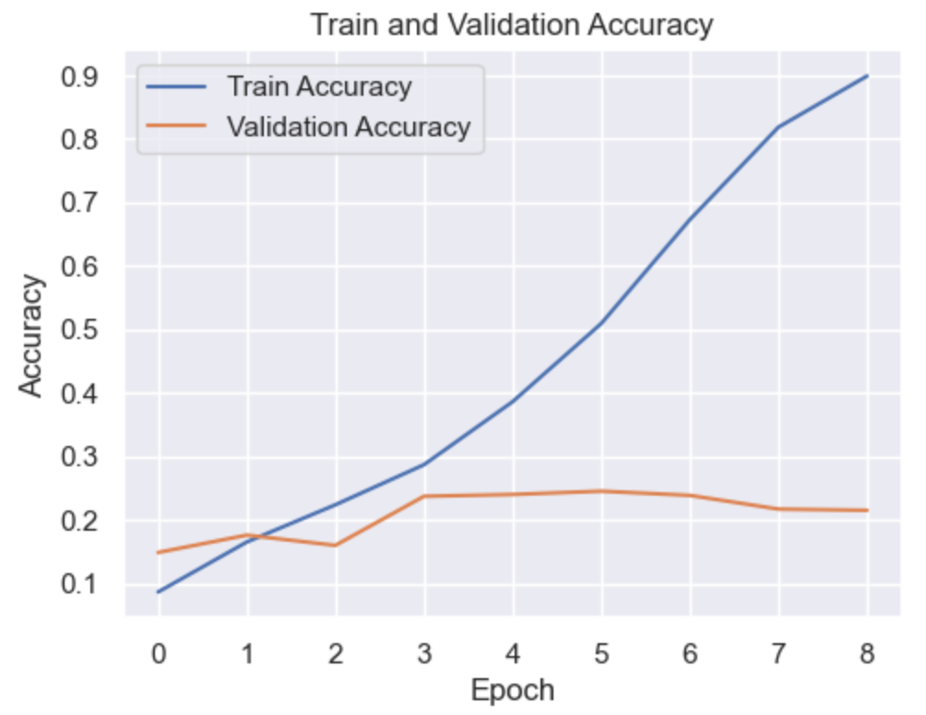
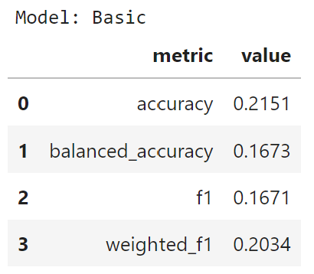
Model 1: Basic CNN
This model overfits the data.
By the end of training, the train accuracy is around 90% while the validation accuracy has leveled off closer to 20%.
This model classifies images much better than random guessing.
However, the test accuracy is only around 21% while the balanced accuracy is even lower, so this is not a great model.

Slide 7
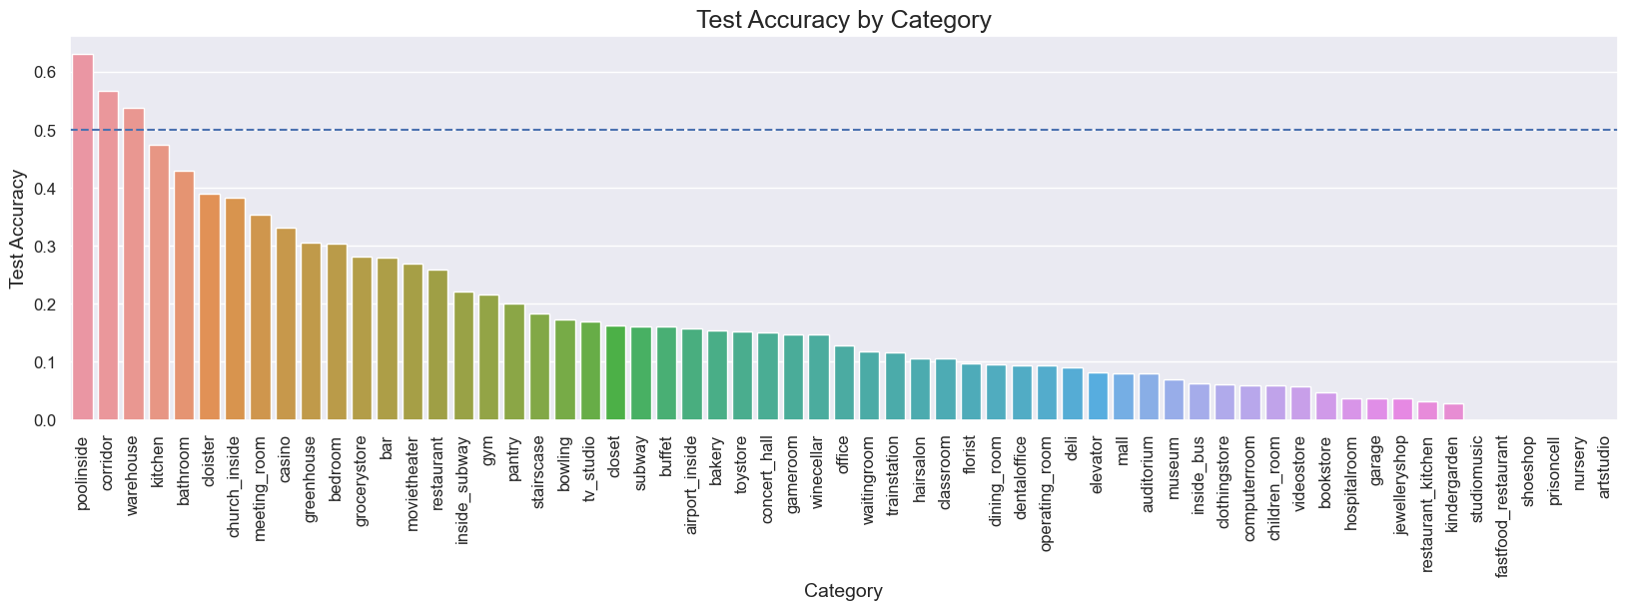
Model 1: Basic CNN
Only 3 out of 61 categories (pool inside, corridor, and warehouse) have test accuracies above 50%.
Most of the categories have very low accuracies (under 20%).

Slide 8
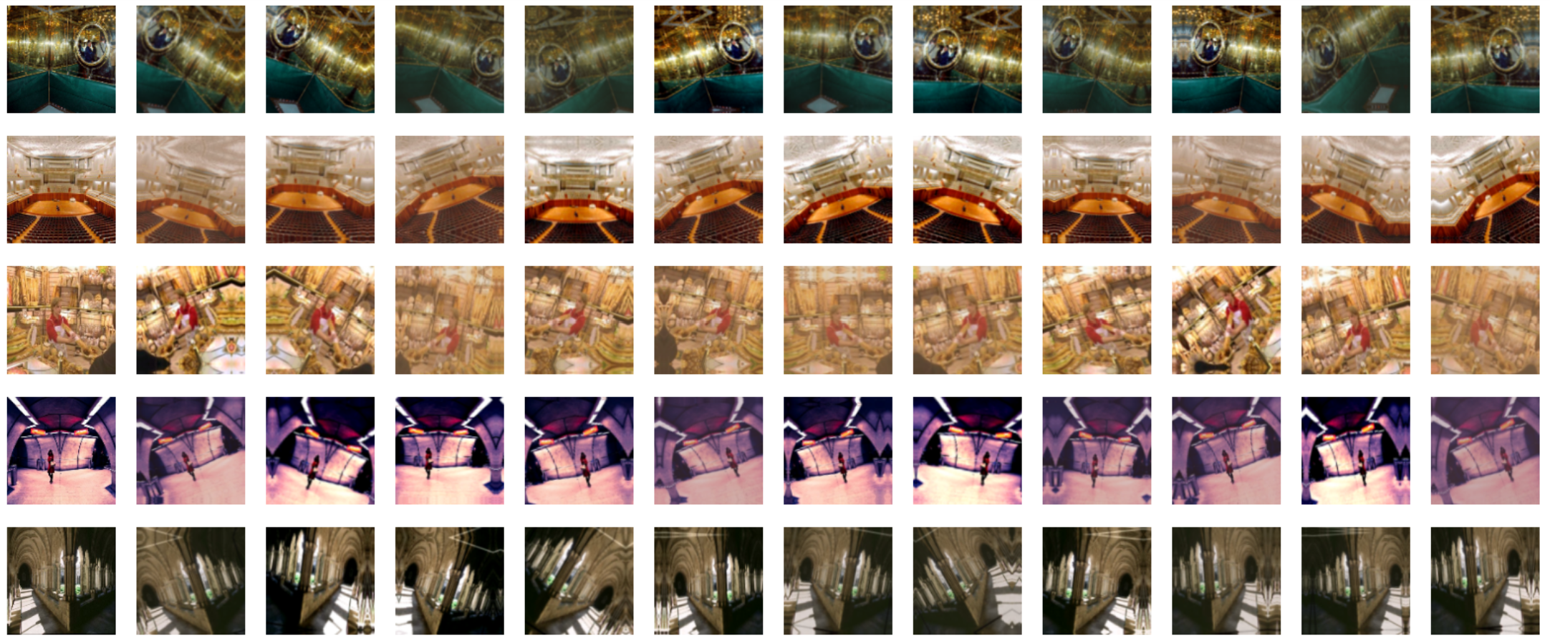
Data Augmentation
Random Contrast, Random Flip, Random Rotation, Random Translation, Random Zoom

Slide 9
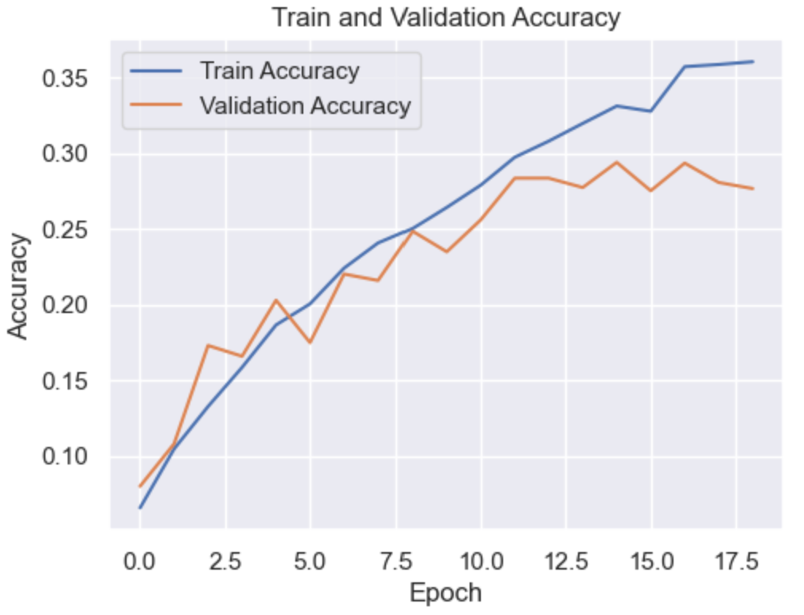
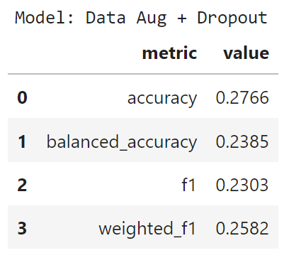
Model 2: CNN with Data Augmentation and Dropout
Data augmentation and dropout significantly reduce the overfitting problem present in the first model.
This model’s metrics are better than those for the first model.
However, the balanced accuracy is still below 25%.

Slide 10
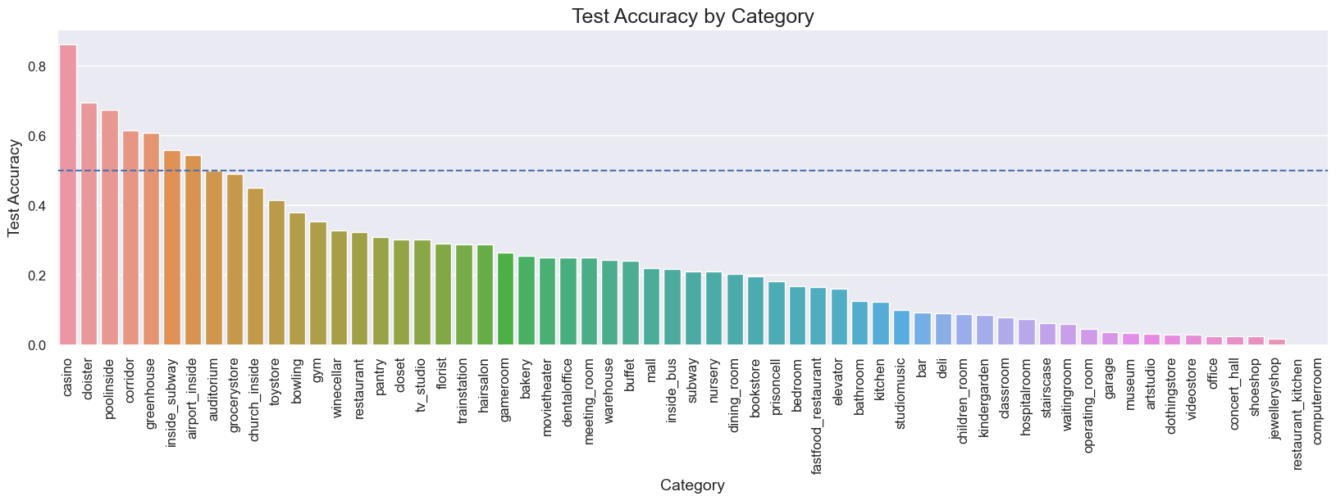
Model 2: CNN with Data Augmentation and Dropout
This model is an improvement compared to the first model.
However, only 7 out of 61 categories have test accuracies above 50%.

Slide 11
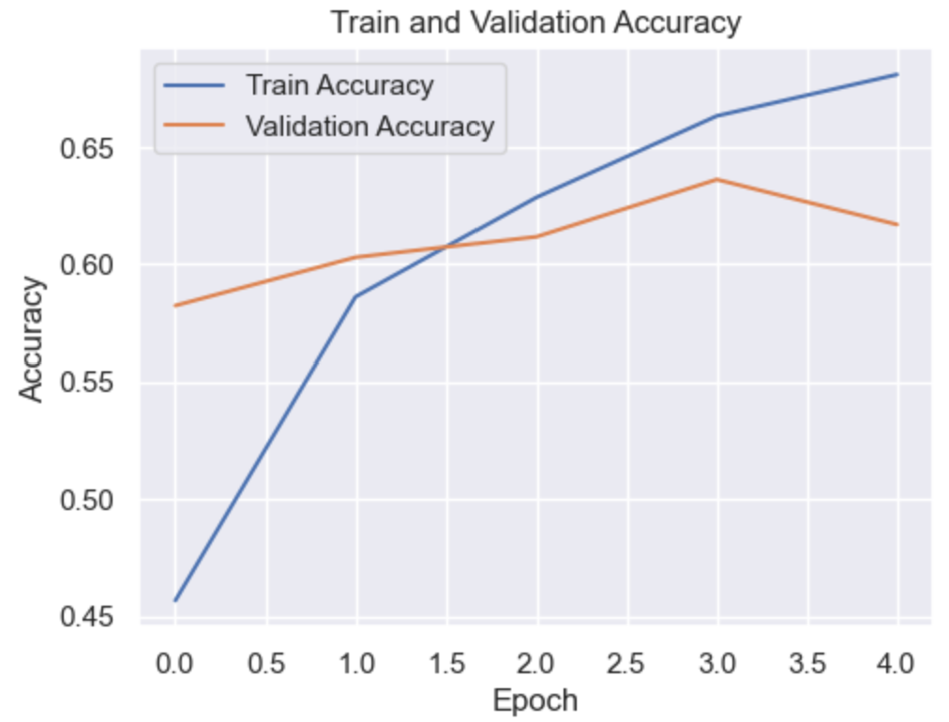
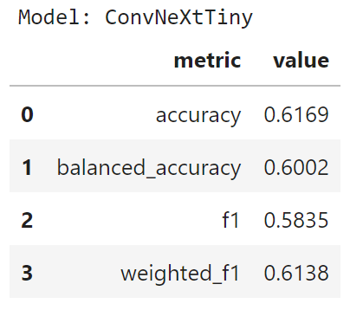
Model 3: Pre-Trained CNN Model (ConvNeXtTiny)
Overfitting is not a major problem for this model.
By the end of training, both the train and validation accuracies are between 60% and 70%.
The metrics for this model are much better than those for the previous models.
Both the accuracy and the balanced accuracy are around 60%.

Slide 12
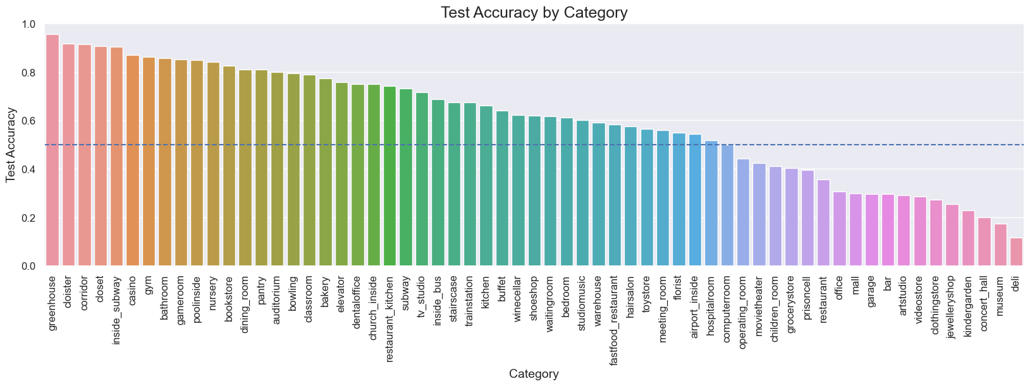
Model 3: Pre-Trained CNN Model (ConvNeXtTiny)
This model is a major improvement compared to both previous models.
42 out of 61 categories have test accuracies above 50%.

Slide 13
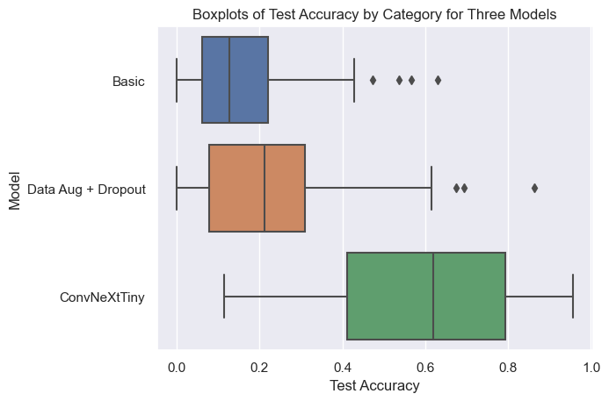
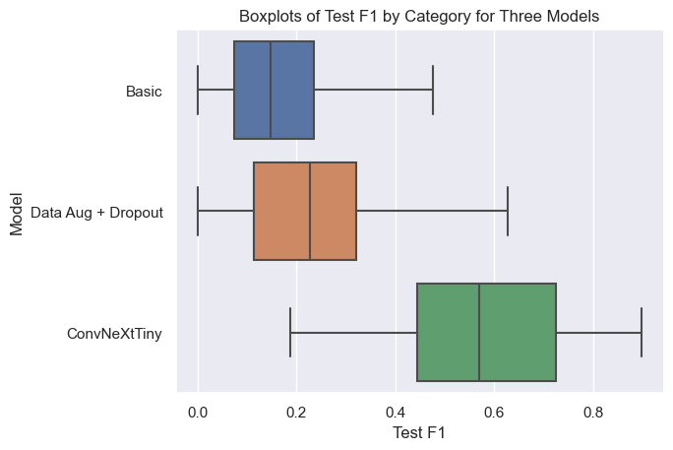
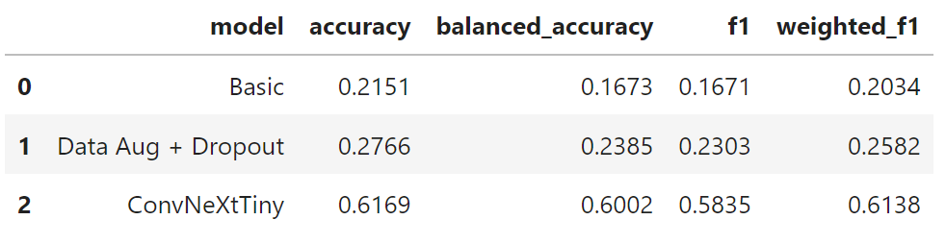
Model Recommendation
I would recommend the pre-trained model because it is a major improvement compared to the other models and has good metrics.
The only drawback of this model is that it is complex and therefore training and prediction take longer than for the simpler models.

Slide 14
Part II
Restaurant Reviews Sentiment Analysis

Slide 15
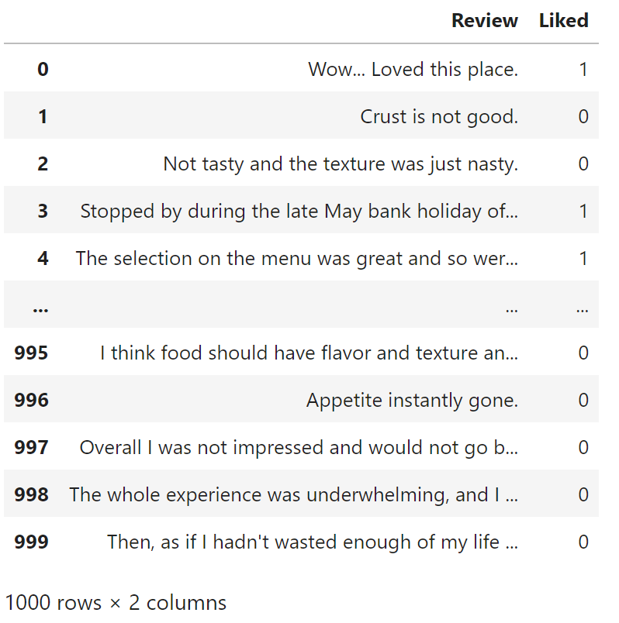
Data and Project Overview
This dataset is from Kaggle and includes 1,000 restaurant reviews.
Columns:
Review: the text of the review
Liked: 0 (did not like) or 1 (liked)
The goal of this project is to predict Liked (the label) using Review (the features).

Slide 16
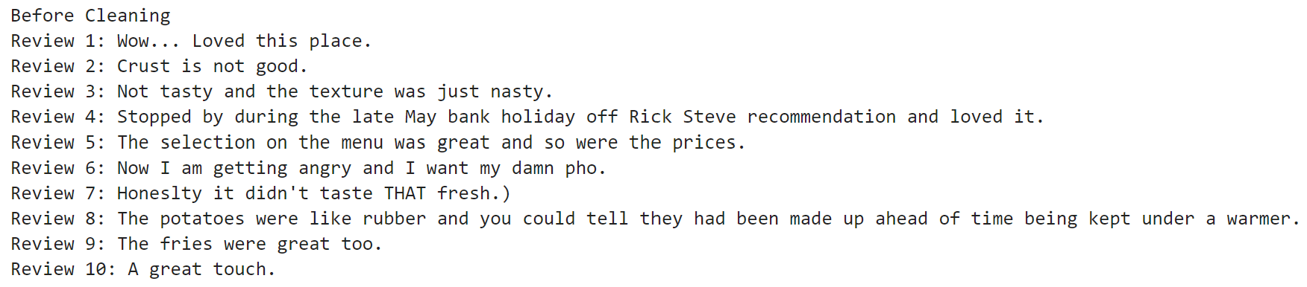
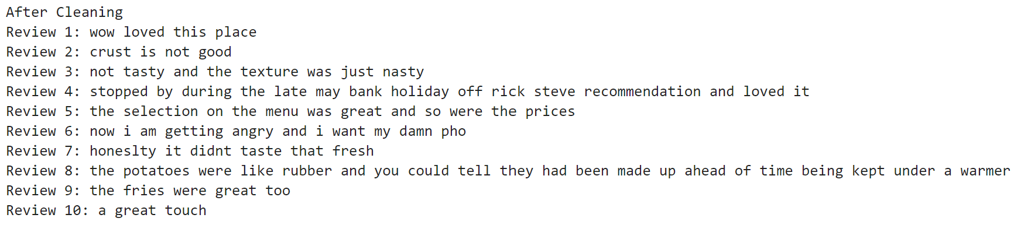
Data Cleaning
Remove non-alphanumeric and non-whitespace characters.
Remove extra spaces.
Convert to lowercase.

Slide 17
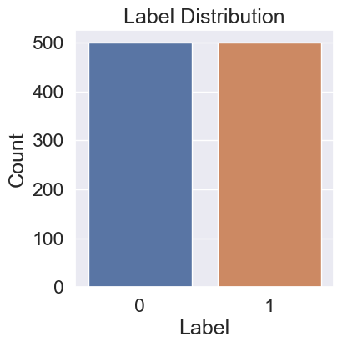
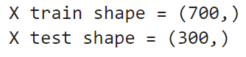
Preparation for Modeling
Examine the distribution of the labels.
This dataset is perfectly balanced, so accuracy is a good metric by which to evaluate the models.
Split the data into a training set (70% of the data) and a test set (30% of the data).

Slide 18
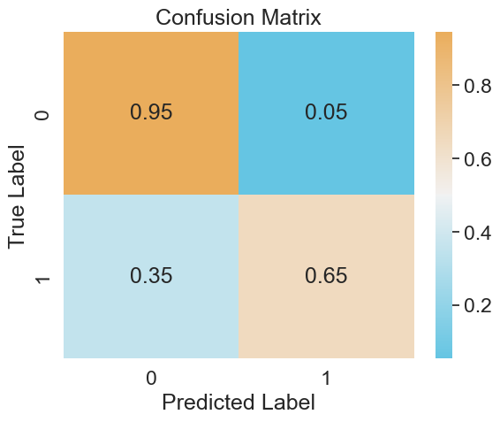
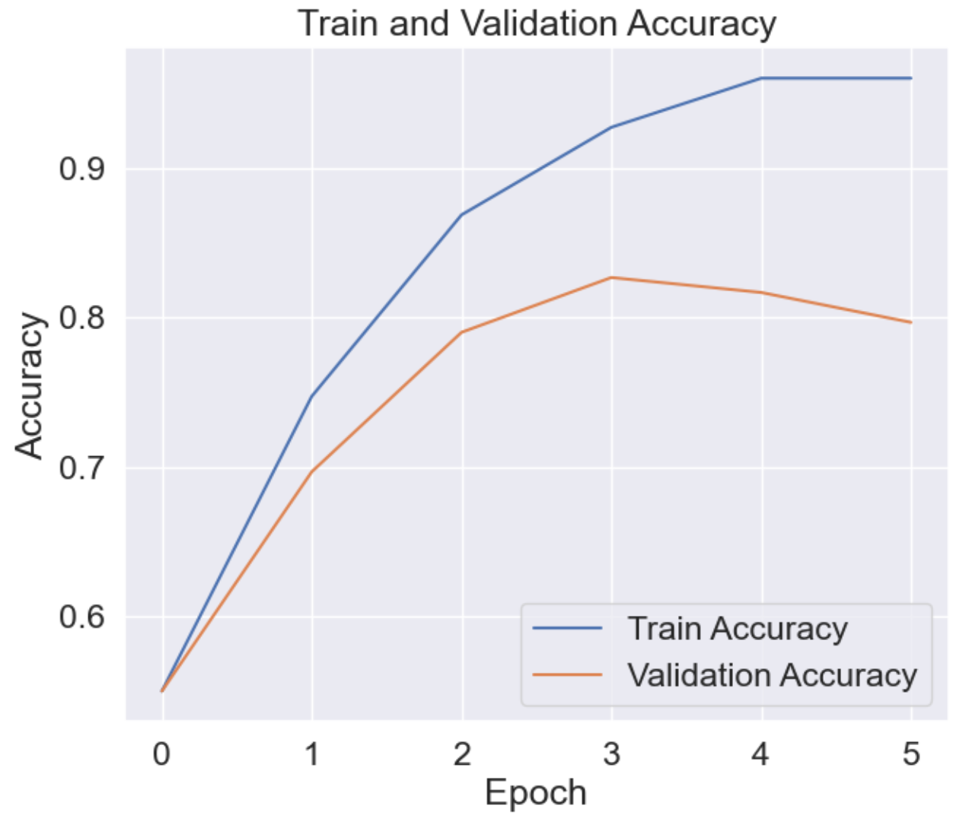
Model 1: RNN with Embedding and GRU
This model has a reasonably good overall accuracy but overfits the data.
This model is also much better at predicting “did not like” (label = 0) reviews than “liked” (label = 1) reviews.

Slide 19
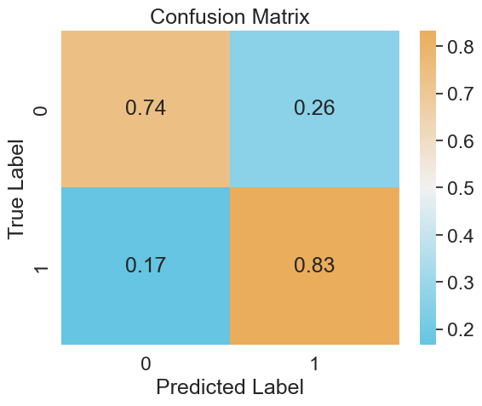
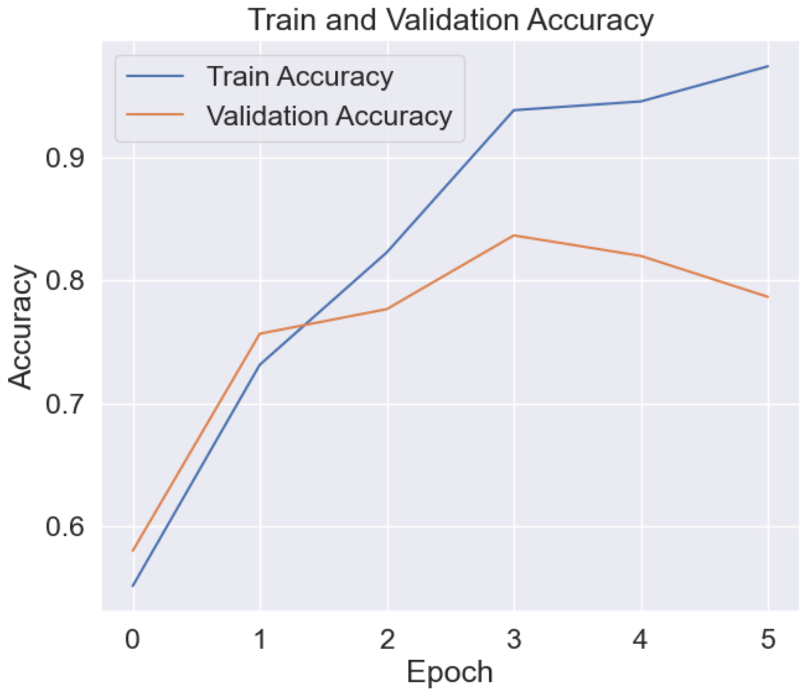
Model 2: RNN with Embedding and LSTM
This model also has a reasonably good overall accuracy but overfits the data.
Unlike the first model, this model is better at predicting “liked” (label = 1) reviews than “did not like” (label = 0) reviews.

Slide 20
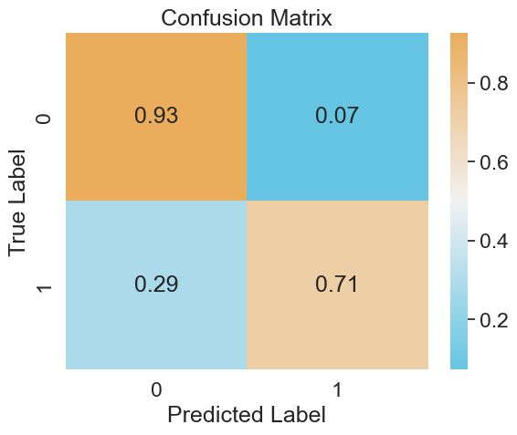
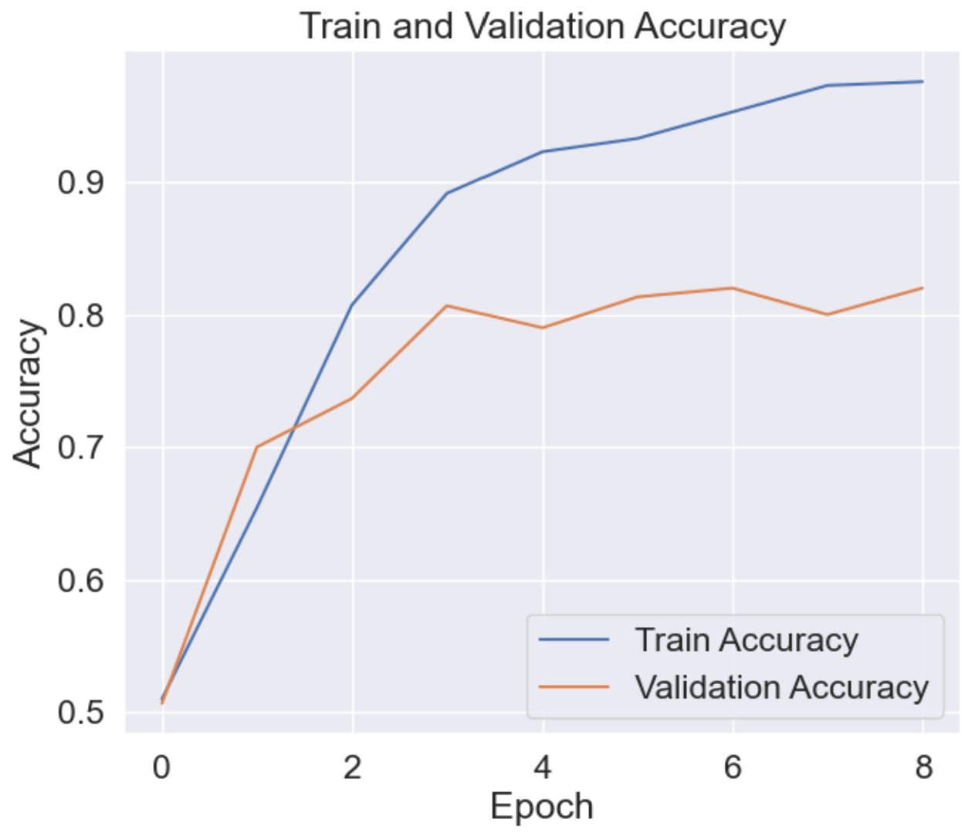
Model 3: RNN with Embedding, GRU, and LSTM
This model performs similarly to the first model (RNN with Embedding + GRU).
Like the first model, this model is much better at predicting “did not like” (label = 0) reviews than “liked” (label = 1) reviews.

Slide 21
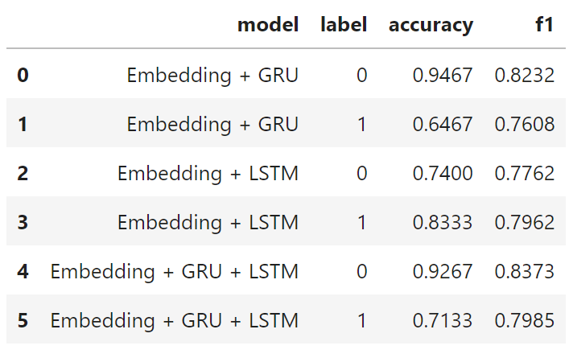
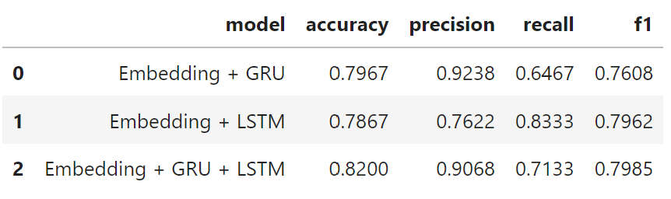
Model Recommendation
All 3 models have similar overall accuracies and f1-scores and overfit the data.
However, I would recommend the second model (RNN with Embedding and LSTM) because its precision and recall are closer in value than the precisions and recalls for the other two models while its accuracy and f1-score are about the same as those for the other two models.

